Slide 1


Nathan Haines
Ubuntu

Slide 2
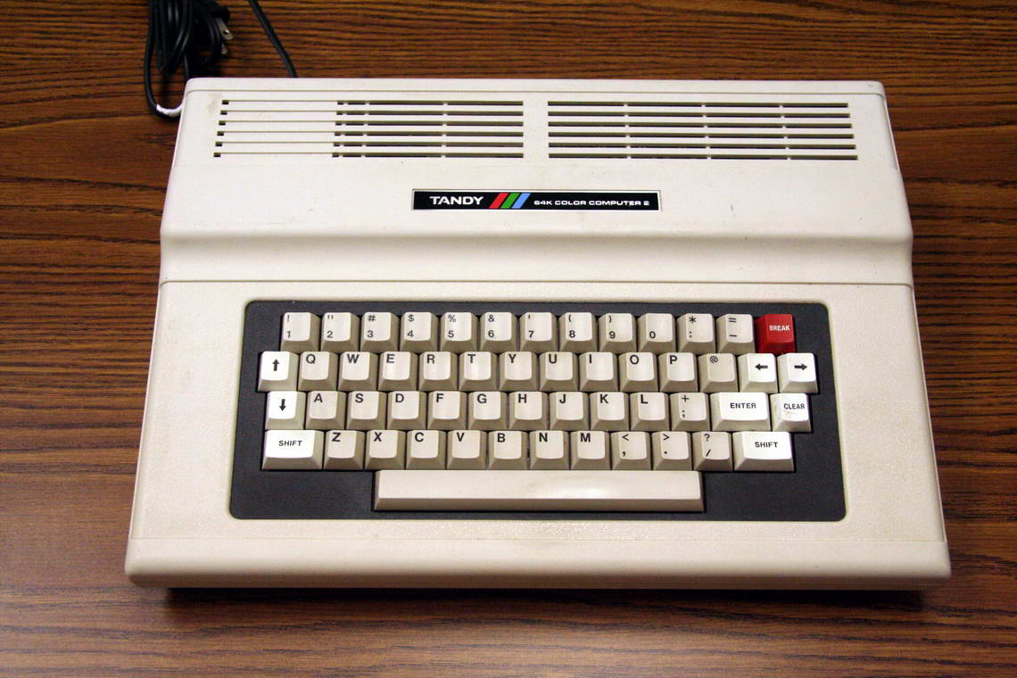
My first computer
Tandy TRS-80 Color Computer 2

Slide 3
Super powerful
0.89KHz CPU
64KB RAM
360KB 5.25-inch floppy drive (add-on)

Slide 4
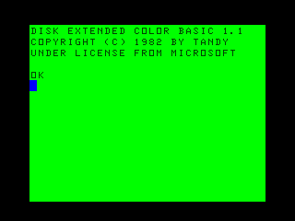
The good old days

Slide 5
The good old days
Instant on
Load a program
Write a program

Slide 6
Shared Software
Everyone could program (a little)
Magazines with source code
Copy that floppy!

Slide 7
An end to a means
Software became valuable
Users encouraged to buy software
Programming becomes arcane

Slide 8
Barriers to entry
License restrictions
Incompatible formats
High software prices

Slide 9
Free Software
Encourages sharing
No restrictions on use
Removes price barrier

Slide 10
Why Free?
All software was “free”
Software was a tool
Programmers would help each other

Slide 11
Free as in freedom
Any use
Study and modify
Share with your neighbor
Share with the world

Slide 12
IBM PC
Came with GWBASIC
Everyone could still program
Software became a product

Slide 13
Complex software
Computers became faster
Software became more complex
PCs became more popular

Slide 14
Computer users
First came the engineers
Next came the enthusiasts
Last came the users

Slide 15
Computers today
Super powerful
Come with one OS
No programming tools included

Slide 16
Software as a culture
Free Software was about sharing
Communities developed
Enthusiasts made new software

Slide 17
Lots of software
As people programmed, more software was available
As more people used software, more features were added
Free software likewise became more complex

Slide 18
A new development
Modem communications
Network services

Slide 19
Cyberspace
Communities formed
Some of them were walled
Some of them were open

Slide 20
World Wide Web
Standard text format
Readable on any system
Links to others' files

Slide 21
Web 2.0
People communicate more and faster
Even easier to publish your own content
Sharing once again rules

Slide 22
Elephant in the room
People are used to sharing
Copyright prohibits some sharing
“Copies” are now perfect and free

Slide 23
Here's where the kids come in
Kids are always networked
Kids are creative
Kids are taught to share

Slide 24
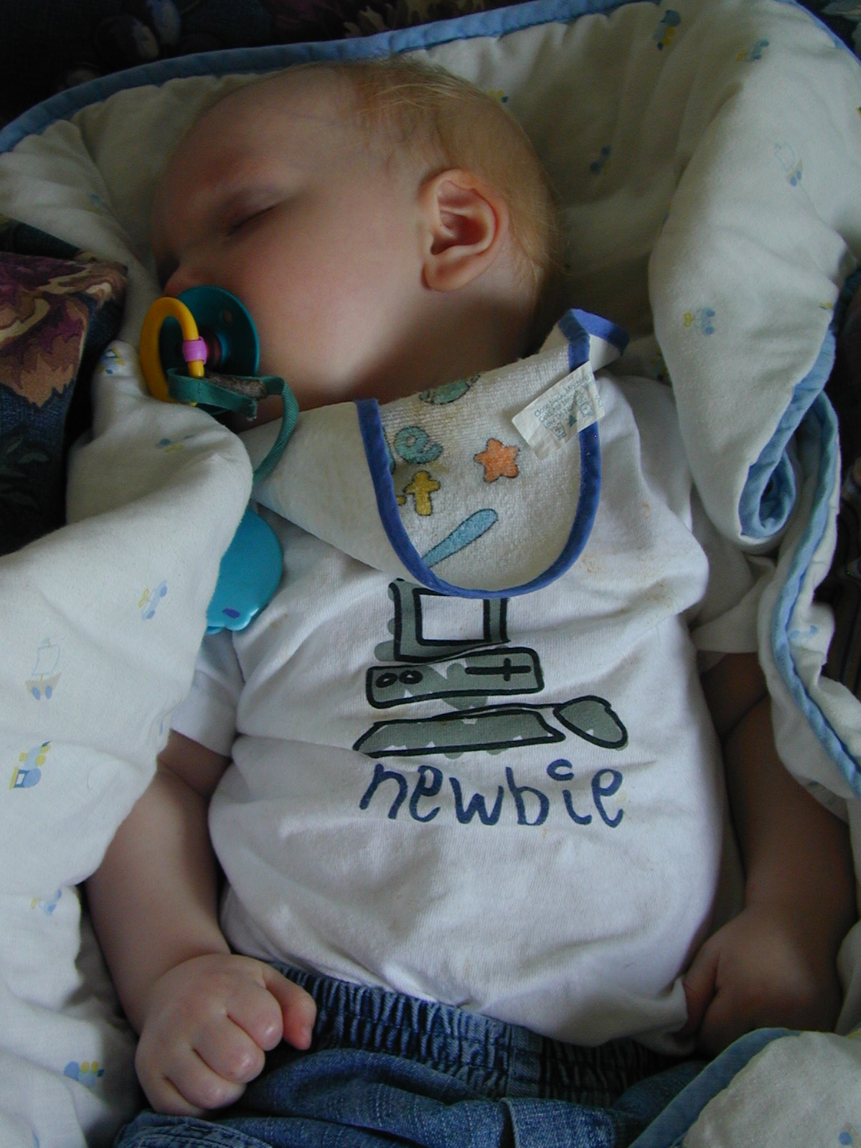
Kids are growing up with computers

Slide 25
Free Software again
Kids have no money
Kids have endless creativity
Free Software saves the day

Slide 26
Instant tools
Free software rivals commercial software
The Internet is worldwide
Tools are within reach

Slide 27
Elephant again
Innovation builds on existing inventions
Instant publishing and instant copying
Moving beyond copyright

Slide 28
Open Content
Instantly allows others to share
Can instantly allow others to build
New rules for a new world

Slide 29
Creative Commons
Do-it-yourself license
Allows reuse with attribution
Commercial or non-commercial use

Slide 30
Completely voluntary
Author retains copyright
Author can grant additional licenses
Others benefit

Slide 31
Wikipedia
Compendium of knowledge
Everyone can chip in
Everyone can redistribute

Slide 32
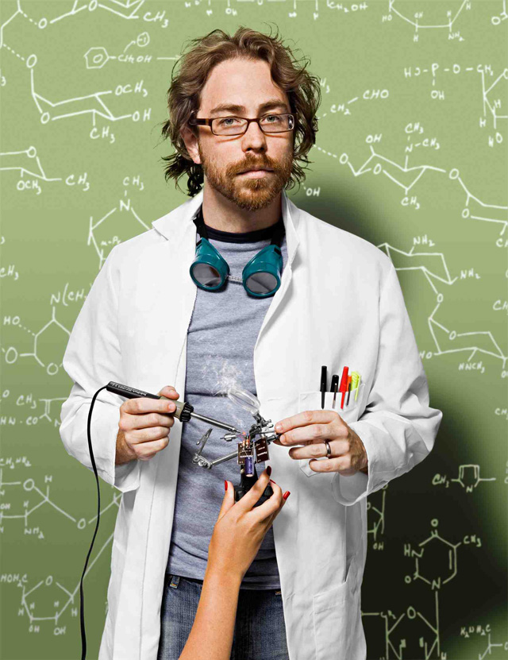
Jonathan Coulton
Decides to be a songwriter
Writes a song a week for a year
Shares with everyone (CC-BY-NC-SA)

Slide 33
Success
Great way to share your work
Allows communities to form around content
Everyone can participate

Slide 34
Culture of sharing
Be excellent to each other
Become involved with content
Collaborate with others

Slide 35
Helping each other
Blender is professional 3D modelling/animation
Blender can be better
Answer: make a movie, make Blender better

Slide 36
Big Buck Bunny

Slide 37
More shinies for everyone!
Blender couldn't do fur-shading or high dynamic range lighting
Big Buck Bunny needed this
Anything Blender couldn't do, Blender developers fixed

Slide 38
Collaboration
Sharing with each other
Helping each other
Sum is greater than the parts

Slide 39
Anyone can do it
Non-programmers can help!
Documentation
Localization

Slide 40
Make, not consume
Pitch in
Be creative
Work together

Slide 41
Nathan Haines
Ubuntu

